Slide 1
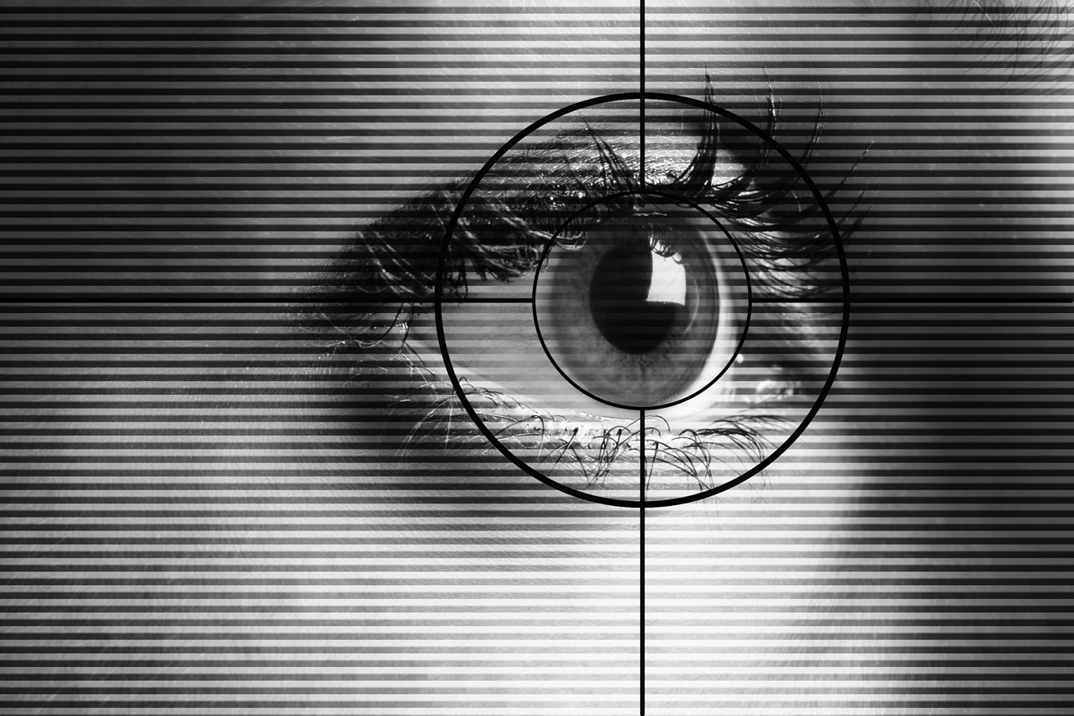
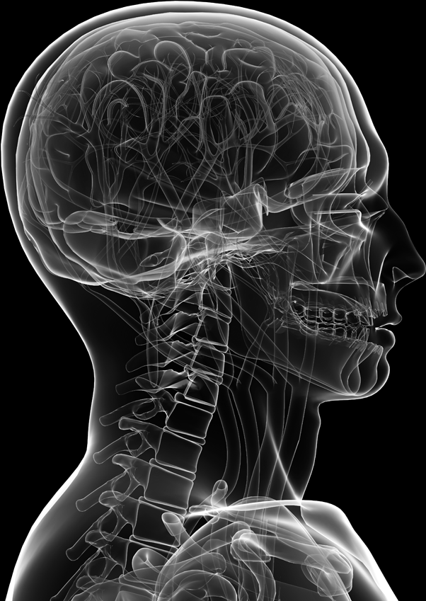
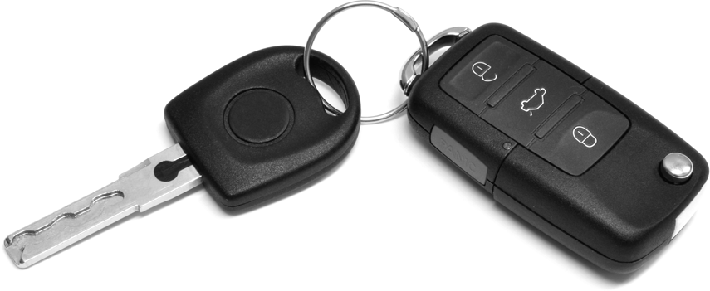
Identification and Authentication
Computer Security

Slide 2
Some Terms
Identification
Establishing who or what an entity person claims to be
Who is this entity?
Authentication
Establishing that the entity really is what it claims to be
Is this entity really what they claim to be?
Authorisation
Establishing what the entity is allowed to do
What resources can they access/interact with?

Slide 3
An Example
Consider the following situation when you log into the network in the labs:
You type in a user name
You are claiming that you are a particular person
Identification
You type in a password
You are supporting or proving your claim
Authentication
The OS and the network decide which resources you can and cannot access
Authorisation

Slide 4
Other Examples
Sometimes a technology can be used for either identification and/or authentication
Fingerprints
Police could use fingerprint technology at a crime scene to try to identify people that might have been present
Fingerprints can also to prove the claim that a person might make about their identity
An ID badge
This might both identify and authenticate a person

Slide 5
Authentication without disclosure of identity
Some systems try to authenticate users without actually disclosing the identity of the subject
Essentially the system knows that the subject is either authentic or not authentic but does not know the identity of the subject
Can you think of an example?
However identity is necessary if we want to enforce different authorisation controls on a per user basis
Or relate actions to a particular user

Slide 6
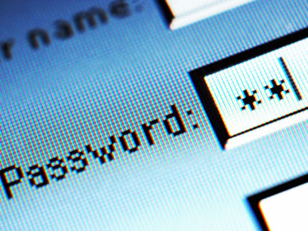
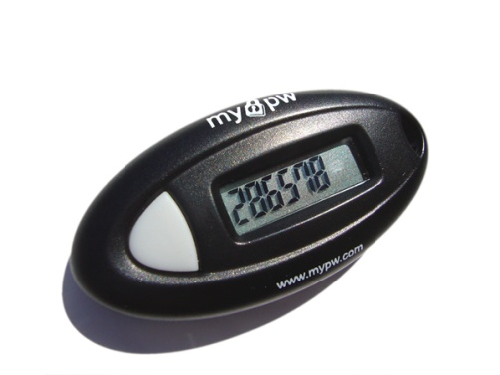
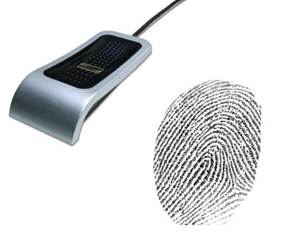
Identification and Authentication
3 approaches:
Something you know
Passwords
Answers to questions
Secret handshakes, symbols etc
Something you have
ID card
Token
Private key
Something you are
Biometric characteristics

Slide 7
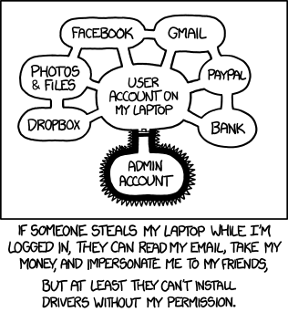
Something You Know
Username
Password
Date of birth
Address
Phone number
Etc…

Slide 8
Passwords
A very common mechanism
Commonly used for authentication
Relies on the fact that the correct person knows something that others don’t
Not necessarily unique to one person
Someone could tell others their password
Just because one person possesses that knowledge doesn’t stop someone else from possessing it

Slide 9
Strength of Passwords
There is quite a spectrum of password strengths ranging from those that provide no protection to those that provide strong protection
Guessable Passwords
Names of family members, pets, birthdays etc
Words not related to user
Alphabetic characters forming a non-meaningful word
Mixture of unrelated alpha and numeric characters
Default Passwords
Blank Passwords
Weak protection
Strong protection

Slide 10
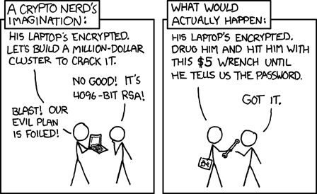
Password strength?

Slide 11
Passwords
Blank or default passwords have obvious issues
Using meaningful and related words such as names of friends, family pets etc. could be guessed by somebody that knows the person
Using words made up of alphabetic characters but unrelated to the person can still be vulnerable to dictionary crackers
Using words unrelated to the person and made up of a mixture of alpha and numeric characters offers much greater protection, but are still vulnerable to brute force attacks

Slide 12
Problems with Passwords
Will the user disclose the password to another person intentionally, accidently or because they were deceived?
Will the user be able to regularly enter the password correctly?
Will users be able to remember their passwords or will they have to record them somewhere or choose easily guessed passwords?

Slide 13
Storage of Passwords
Operating Systems store passwords in either an encrypted or hashed format
Use one way hash/encryption algorithms
OS never actually decrypts the password
User types in their password
Password is encrypted through the one way function
OS compares hash with hash stored in DB

Slide 14
Using a hash function to store passwords
Initial registration of password
pass=“plumless”
crc32(pass)
4ddb0c25
Hashes compared
Subsequent login attempt
pass=“plumless”
crc32(pass)
4ddb0c25

Slide 15
Hash collisions
What if the hashing algorithm has been poorly chosen/implemented?
Initial Registration of Password
pass=“plumless”
crc32(pass)
4ddb0c25
Hashes compared
Subsequent Login Attempts
pass=“buckeroo”
crc32(pass)
4ddb0c25

Slide 16
Password hashing
crc32() produces a 32-bit hash output
A 32-bit hash has 4,294,967,296 outcomes
md5() might be more suitable as it produces a 128-bit hash output
A 128-bit hash has 340,282,366,920,938,463,463,374,607,431,768,211,456 outcomes

Slide 17
Cracking Passwords
Passwords could be guessed
An attacker may sit at the computer trying every possible password combination
Many operating systems, networks and applications use account lockouts if an incorrect password is presented several times
Attacker could lift passwords from a computer
Could take them away to their own computer and use a password cracking program
An off-line attack

Slide 18
Off-line Password Cracking
Password attacks often occur off-line using
Dictionary attacks
Brute force attacks
Hybrid attacks
These can be very computationally intensive
An i7 processor can crack most passwords quite quickly
What about a cluster of computers?
What about a GPU? Or a cluster of GPUs?

Slide 19
Dictionary Attack

Slide 20
Brute Force Attack
Notes:
Program tries to encrypt the letter ‘a’ using the one way function
If it matches the captured password the password is known
If not it will try the letter ‘b’
When it gets to ‘z’, it might try ‘aa’, ‘ab’ etc
Such a program would include numeric and other characters as well
This would obviously take a lot of time

Slide 21
Hybrid Attacks
This type of attack will take a dictionary word and then add characters at the start and the end of the word in a brute force manner
This is designed to crack passwords that are based on a dictionary word with extra characters added such as ‘Hello123’

Slide 22
Success Factors
For these offline attacks to work, the attacker needs;
The passwords in their hashed form
Knowledge of the hashing process/algorithm
The ability to test for a match
Significant amounts of time/computing power

Slide 23
Rainbow Tables
Large tables of pre-computed password hashes
You search the table for the captured hash
Generally quicker than brute force and dictionary attacks
They require significant storage space
Consider every single possible word and random characters and numbers being tabulated along with their hash

Slide 24
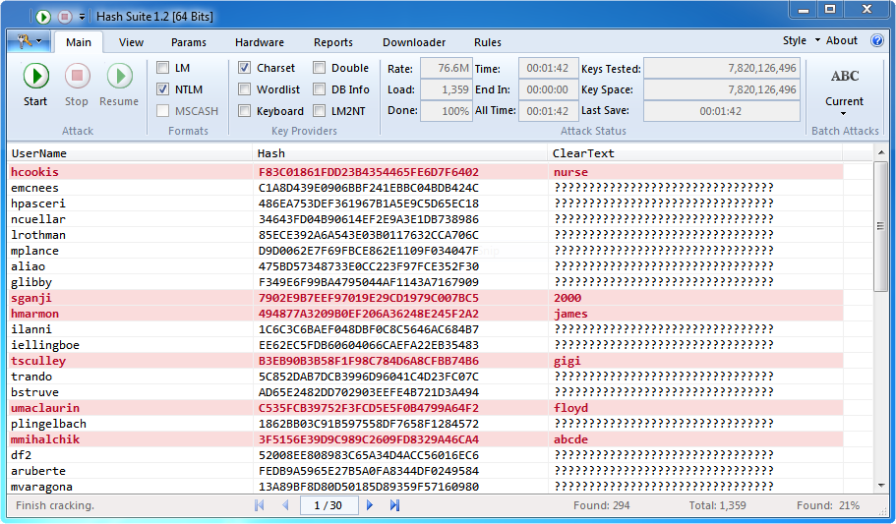
Hash Suite

Slide 25
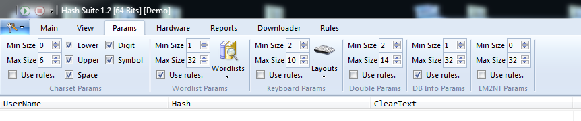
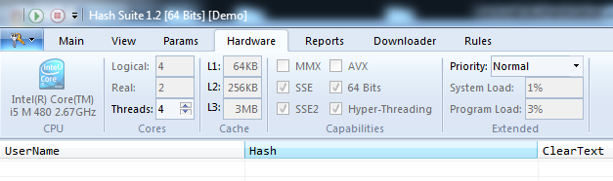
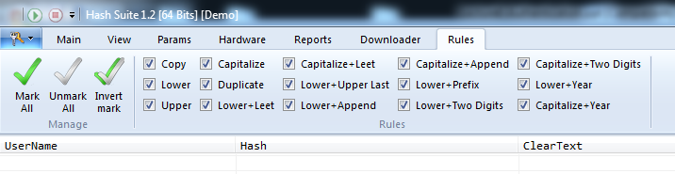
Hash Suite

Slide 26
Hashcat password recovery tool
Hashcat CPU/GPU password recovery tool
Computational Power | MD5 hashes tests per second
6-core AMD CPU | 52.9 M c/s
Radeon 7970 GPU | 8213.6 M c/s
2x Radeon 7970 GPU | ~ 16000 M c/s
1 Radeon 7970 = ~12 days to test all 12 character md5 uppercase, lowercase and number based hashes
4 GPUs? Distributed cluster of GPUs?
hashcat speed results obtained from http://blog.codinghorror.com/speed-hashing/

Slide 27
Good passwords
Good passwords should
Not relate to the person in any way
Be a mixture of alpha and numeric characters
Be reasonably long > 12 characters
Changed regularly
If passwords are too difficult to remember
People will write them down
It is much easier for an attacker to read a password stuck to a monitor with a post-it note than to go to the effort to capture and crack them

Slide 28
Good passwords cont…
However, good passwords are only as effective as the system they are used on
md5 has been academically broken
Is sha1 the answer?
How long before the current computational resources double or triple?
How common will it be for people to use 20 character passwords?

Slide 29
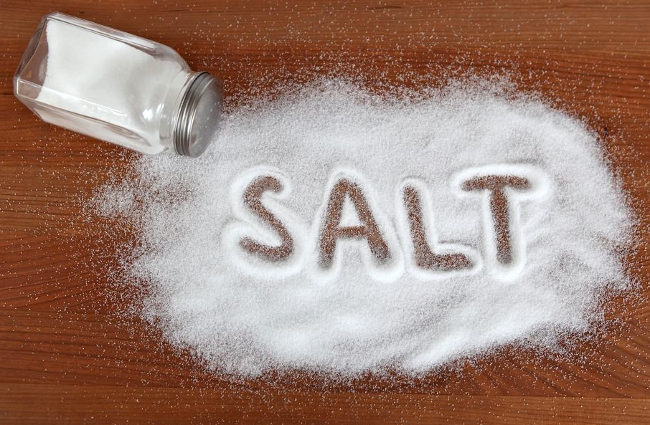
Password salt
Random data used as additional input to a one-way function
End-users will naturally use short passwords
Adding additional random characters will theoretically require additional computational power

Slide 30
Password salt cont…
Concatenate a salt with a password
If the attacker knows the salt they still need to calculate a longer list of hash values requiring additional time/resources before the correct value is found
pass=“test”
pass=“1v$abx&test”
md5sum(pass)
salt=“1v$abx&”
310b4ceaeeb7c926c096ed8f91448c86

Slide 31
Think outside the box
Donald was reading a newspaper story about password security. Donald decided to implement strict rules regarding the passwords used by employees in his company.
Donald decided that:
Staff passwords would need to be at least 16 characters long.
Staff would need to change their passwords every week.
Every password would need to contain letters, digits and symbols.
The same password cannot be used more than once.
List 5 issues you foresee with Donald’s proposal?
How could you improve upon his proposal?

Slide 32
Something That You Have
Smart card
Token
Private key

Slide 33
Private Key
Private key
Included as something you have because not too many people commit their private keys to memory
Often accessed via a passphrase

Slide 34
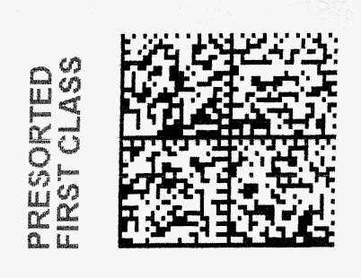
Barcodes
Developed in the 20th century to improve efficiency in grocery checkout.
First-generation barcodes represent data as a series of variable-width, vertical lines of ink
Recent barcodes are rendered as two-dimensional patterns using dots, squares, or other symbols that can be read by specialized optical scanners

Slide 35
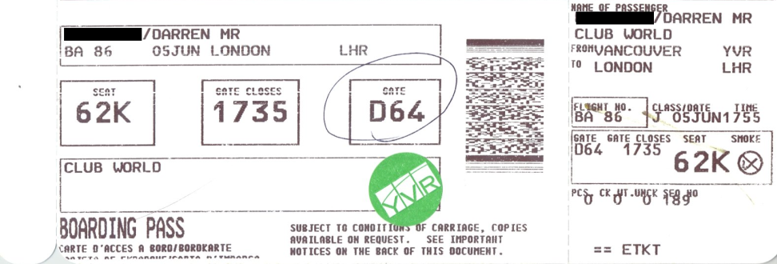
Barcodes
The airline industry has been using two-dimensional barcodes into boarding passes
The barcode is encoded with an a unique identifier allowing staff to look up the passenger’s record with that airline.
Barcodes provide convenience but are easy to duplicate

Slide 36
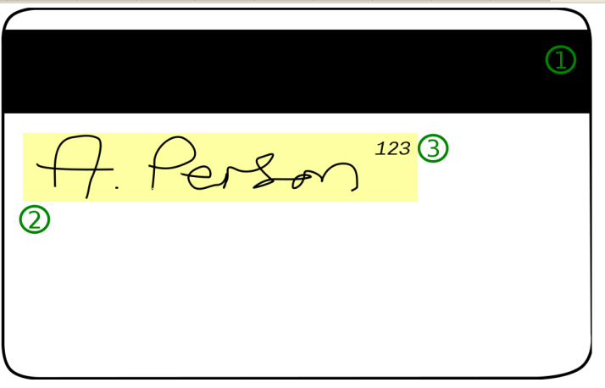
Magnetic Smartcards
Plastic card with a magnetic stripe divided into 3 tracks (each 2.79mm wide)
1st track contains cardholder’s name, account number, and data format information
2nd track may contain account number, expiry date, issuing bank info

Slide 37
Magnetic Smartcard Security
Magnetic stripe medium is that it is easy to read and reproduce
Magnetic stripe readers can be purchased at relatively low cost approximately $50-$100
When coupled with a magnetic stripe writer, which is only a little more expensive, an attacker can easily clone existing cards

Slide 38
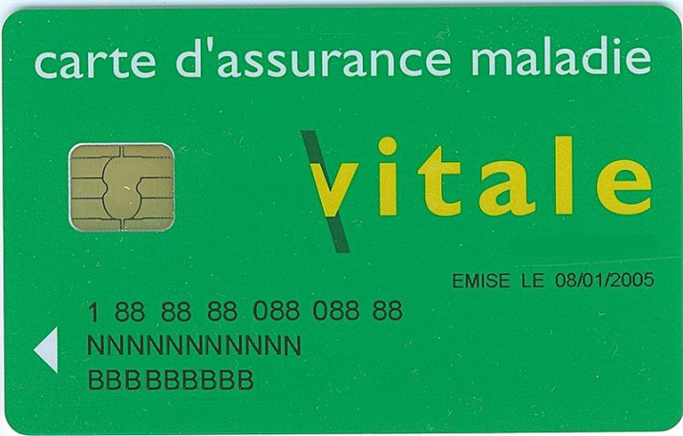
Circuit Based Smartcards
A plastic card with an integrated circuit
May include a microprocessor allowing the data on the card to be read and written to
Much more secure than magnetic smart cards but vulnerabilities do already exist

Slide 39
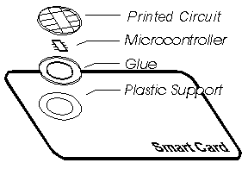
Structure of Circuit Smartcards
Source: Philips DX smart card reference manual, 1995

Slide 40
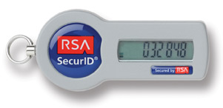
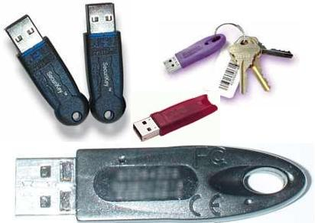
Tokens
Time stamp tokens generate a random number changing every 30 – 60 seconds
USB tokens communicate with a
server when software is used

Slide 41
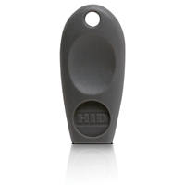
RFID
Radio frequency Identification Tags
Small devices that can be used for identification and authentication
Most operate within fairly short ranges
Many apartment buildings utilise RFID based token to grant occupants access to the building
Embedded in passports, products
people?

Slide 42
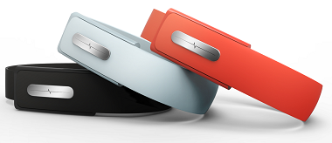
Wearable authentication devices
Nymi works by using your unique electrocardiogram (ECG) signals to act as a biometric authentication layer for other devices, applications and services

Slide 43
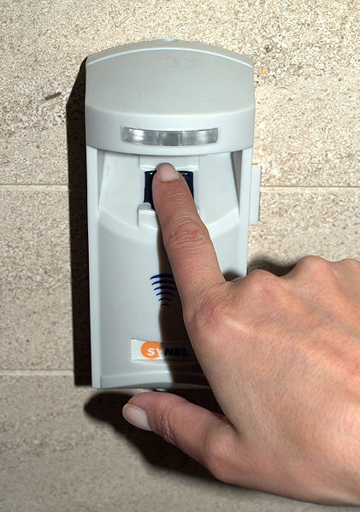
Something That You Are

Slide 44
Biometrics
Biometrics are physiological or behavioural
Physiological measures inherent physical characteristics
Behavioural systems measure the way in which people act or perform tasks

Slide 45
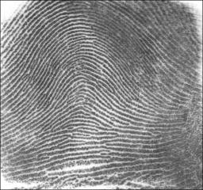
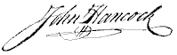
Physiological vs. Behavioural Biometrics
Physiological
Iris
Retina
Finger prints
Hand geometry
Face recognition
Behavioural
Keystroke analysis
Signature analysis
Voice analysis

Slide 46
Biometrics Process
Initial Registration of User
Initial Sensor Reading
Set Confidence Limits
Subsequent Authentication Attempts
Database
Sensor Reading
Comparison with stored template
Within Confidence Limits?
Outside Confidence Limits?
User is authenticated
User is not authenticated

Slide 47
Confidence Limits
Each sensor reading will be slightly different
Ambient light, noise
The subject’s alignment with the sensor
Confidence limits allow for slight variation
How to determine optimal confidence limits?
Too relaxed and we might authenticate an impostor
Too tight and we might reject the real person
Unfortunately the confidence limits may be fixed by the device itself and may not be user configurable

Slide 48
Biometric Errors
False Acceptance (False positive or Type I error)
Scan falls within the confidence limits, even though subject is not the authentic person
Need to adjust False Acceptance Rate (FAR)
False Rejection (False negative or Type II error)
Scan falls outside the confidence limits, even though subject is the authentic person
Need to adjust False Rejection Rate (FRR)

Slide 49
Type of Subject
Cooperative subject
Submits to biometric sensor reading
Non-Cooperative subject
Doesn’t explicitly submit to sensor reading but takes no action to avoid it
Uncooperative subject
Takes active steps to avoid sensor
Eg covers face to avoid a camera

Slide 50
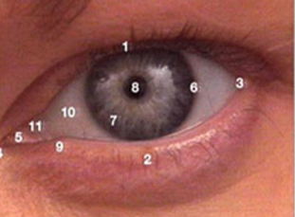
Iris Recognition
Measures characteristics of the human iris
Can use a mixture of visible light and infrared imaging
Higher end models can be difficult to fool
Probability of two people returning exactly the same Iris scan result are 1 in 10^52
Very accurate (except for early models which could be fooled with a printed picture…)

Slide 51
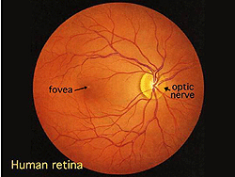
Retina Recognition
Examines the back of the eye
Requires the subject to be co-operative
Patterns of blood vessels can be uniquely identifying
Usually uses infrared imaging
Quite expensive

Slide 52
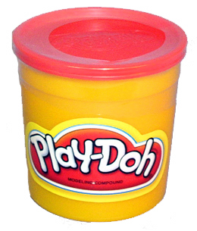
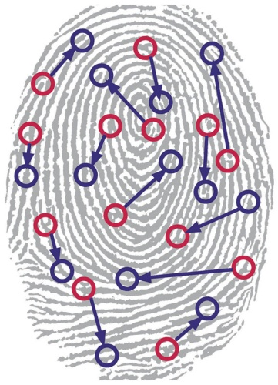
Fingerprint Biometrics
Used for many years
Quite accurate
Easy to use
Easy to replicate using play-doh
Measures patterns of ridges and furrows
Some stigma attached to being fingerprinted
Even identical twins have distinct fingerprints

Slide 53
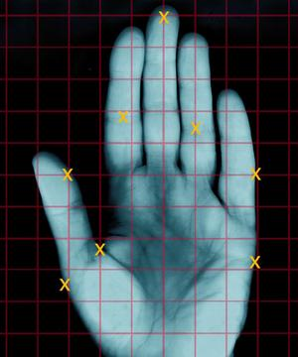
Hand Geometry
Measures physical features of the hand
Length in width of fingers
Curvature of fingers
Distance between knuckles etc
Easy to use
Not as accurate as other biometric methods
Usually uses optical imaging
Only really useful for authentication
Substantiating someone’s claim if identity
Not good for identifying people without such a claim

Slide 54
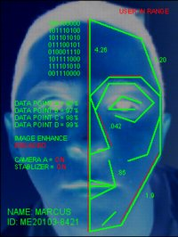
Face Recognition
Uses optical video cameras as a sensor
Can be used for authentication and identification
Performance for identification drops when dealing with greater numbers of people
Often does not require subject to be co-operative
Could capture images as people walk down a hallway
Most effective with cooperative subjects
Can cope with non-cooperative subjects
Not good at dealing with uncooperative subjects

Slide 55
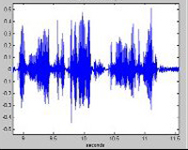
Voice Recognition
Uses a microphone as a sensor
Often quite inexpensive
When registering, systems will often ask subjects to record the answers to several questions
System asks a random question each time
Helps to prevent the recoding and playback of a subject’s voice
Often not very accurate
Variation in voice from stress, colds, flu etc.

Slide 56
Keystroke Analysis
Individuals type at a keyboard in different ways
On going authentication
User can be re-authenticated repeatedly while using a system
People typing habits can be quite variable
Not as accurate as iris scans etc

Slide 57
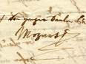
Signature Analysis
Subjects use a stylus and/or a pressure sensitive pad and write their signature
Signature recognised by measuring
Speed
Stroke
Pressure
Most people sign their name slightly differently each time
Some systems can differentiate between habitual and variable sections of the signature

Slide 58
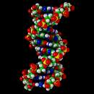
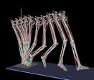
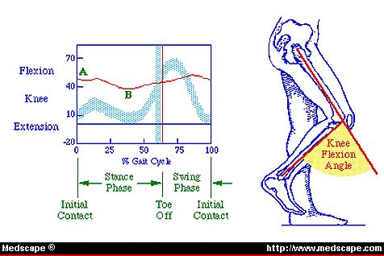
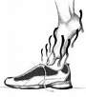
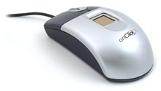
The Future
Gait analysis?
Using radar or other sensors to measure the way in which people walk, move etc.
Biometrics based DRM on multimedia?
So only you can listen to that tune or read that eBook

Slide 59
Resistance to Biometrics
Privacy concerns are an important issue with biometrics
As biometrics become more widely used these concerns become more widespread
E.g. Some countries are beginning to use biometrics at airports, in passports etc
What happens to all of that information?
What databases will it end up in?
What data will it be matched with?
What assurances do we have that these databases will be accurate?

Slide 60
Inhibiting Factors
If biometrics solve so many problems, why do we not use biometrics for everything?
Are the following factors inhibiting the adoption of biometrics?
Social
Cultural
Religious
Technical
Economic
Practical
Others?

Slide 61
Future biometric uses...
Imagine a situation in which we used fingerprint scanners to
start our car
open our front door
access medical records
Withdraw money from out account
Would you normally use the same password for all of these things?
Also, we can change passwords regularly, we can’t really change our thumbs

Slide 62
Concluding Remarks…
Is this ability to identify and authenticate necessarily a good thing?
Will we get to a stage where every action can be:
Recorded?
Authenticated?
Cross checked and matched with other actions?
Is the notion of cash dead?
In what areas of our lives to we still have any degree of anonymity?
Is there really any any notion of privacy left?
More on this in the Privacy Module…

Slide 63
